Slide 1
Challenge Tracking Deck
Risk Management Planning for B2B Initiatives
UPDATED: 01.01.2023

Slide 2
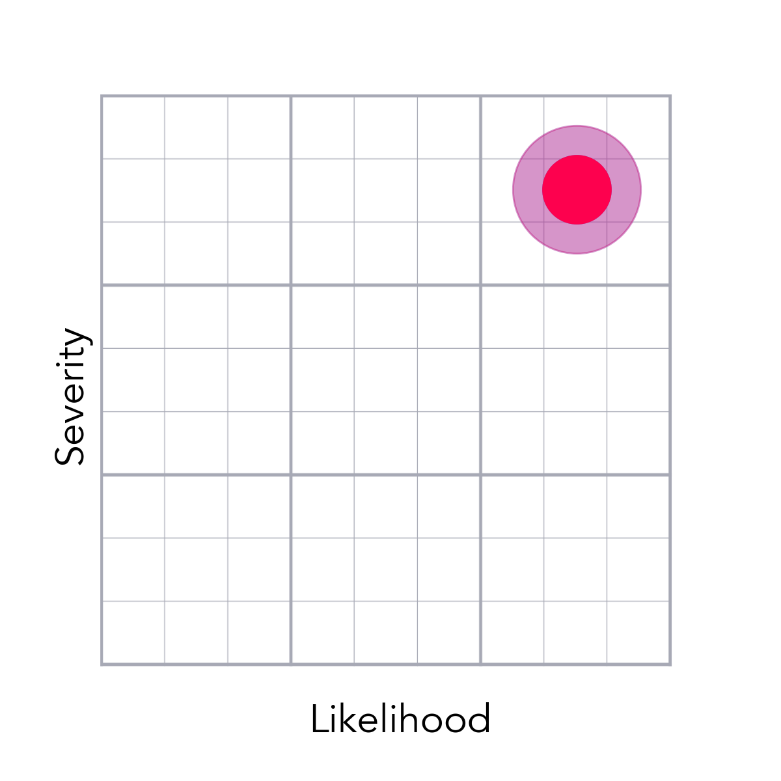
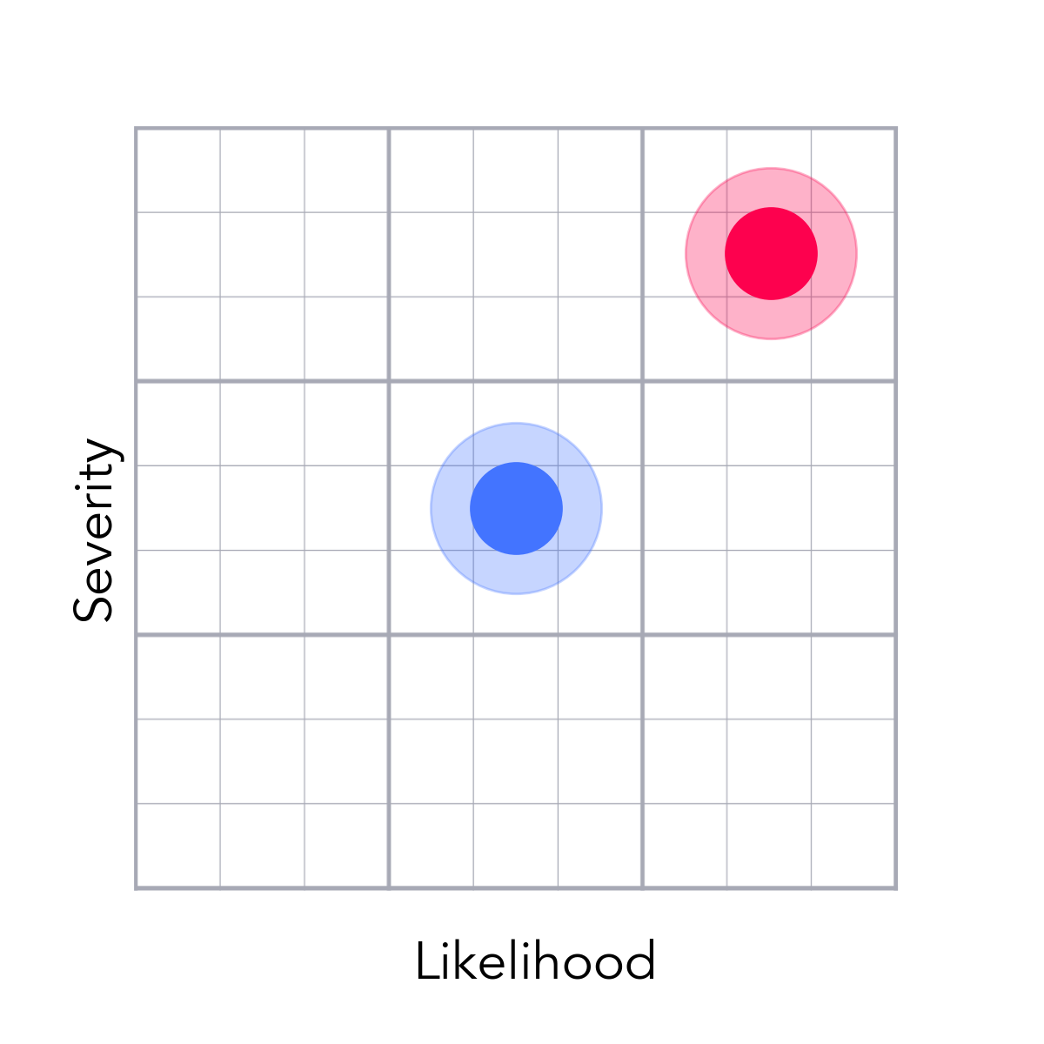
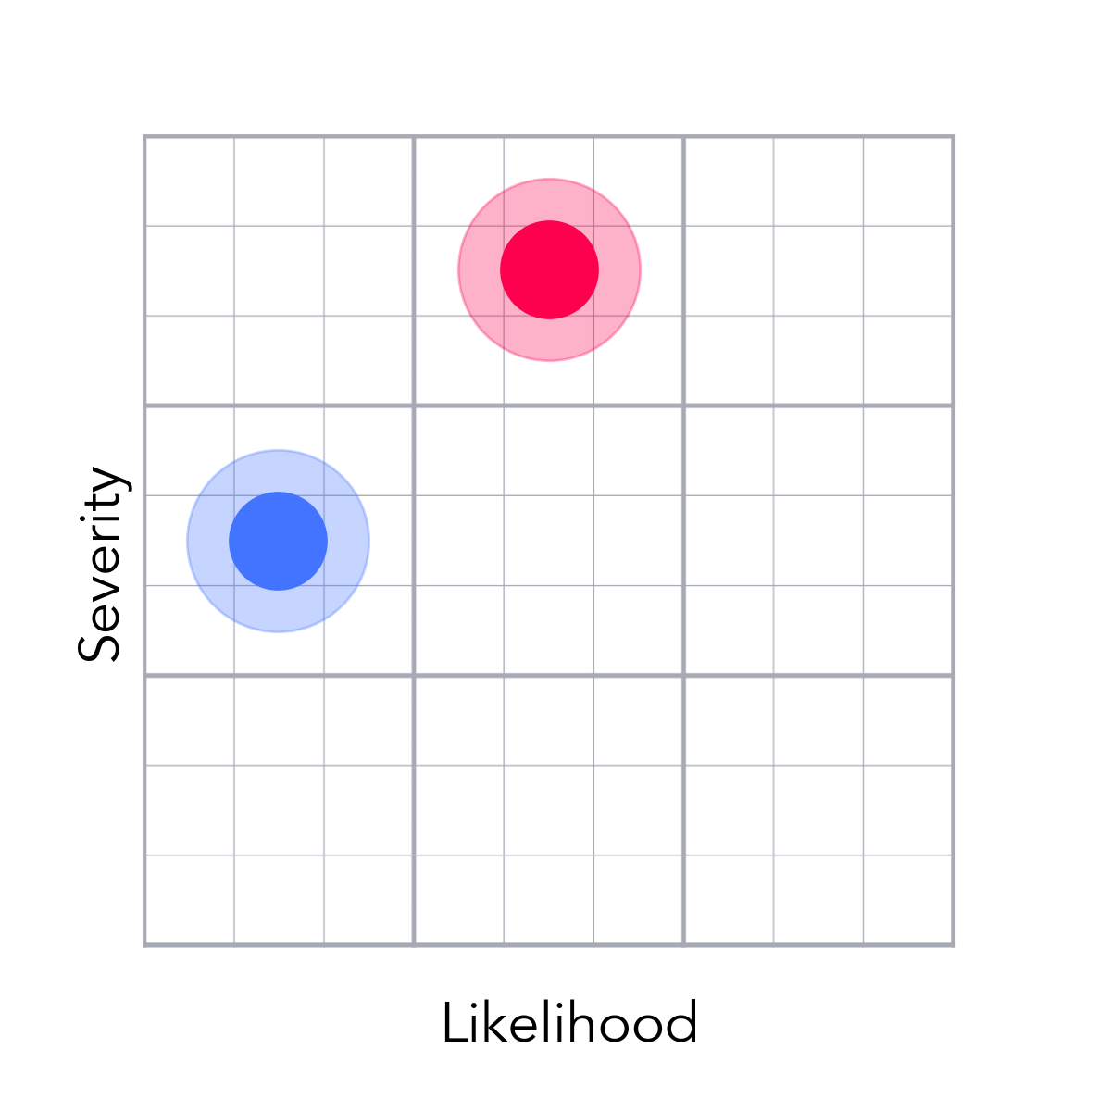
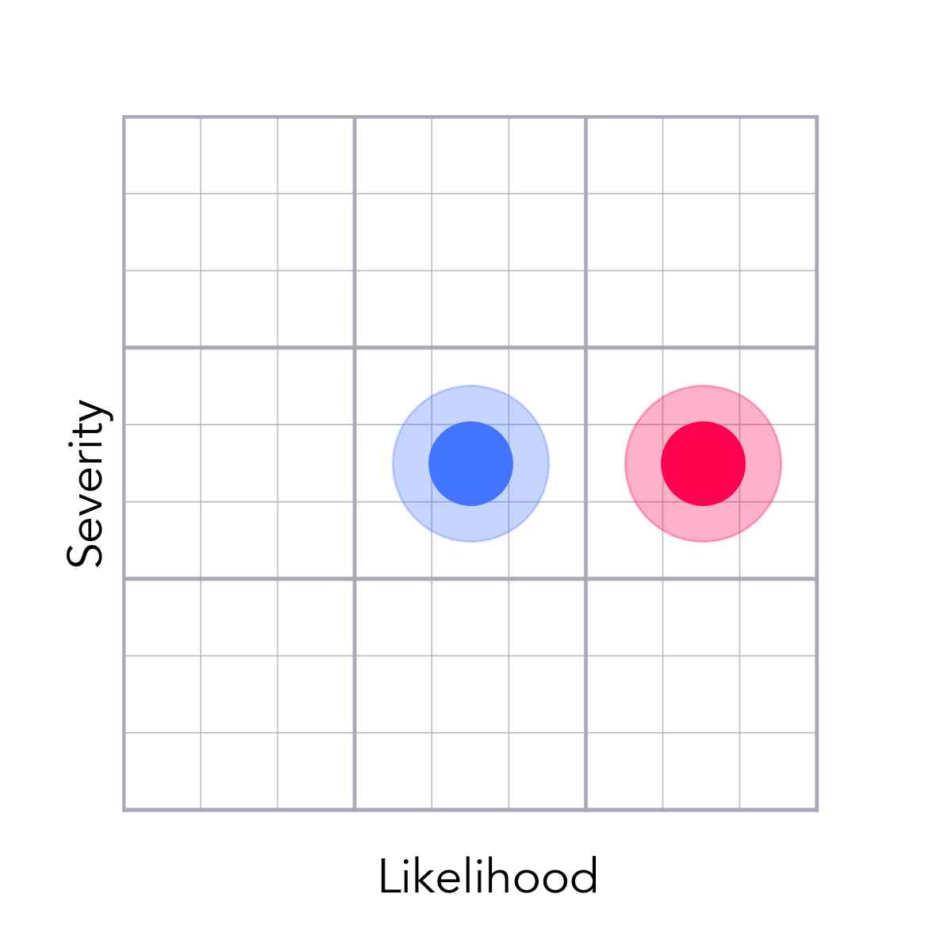
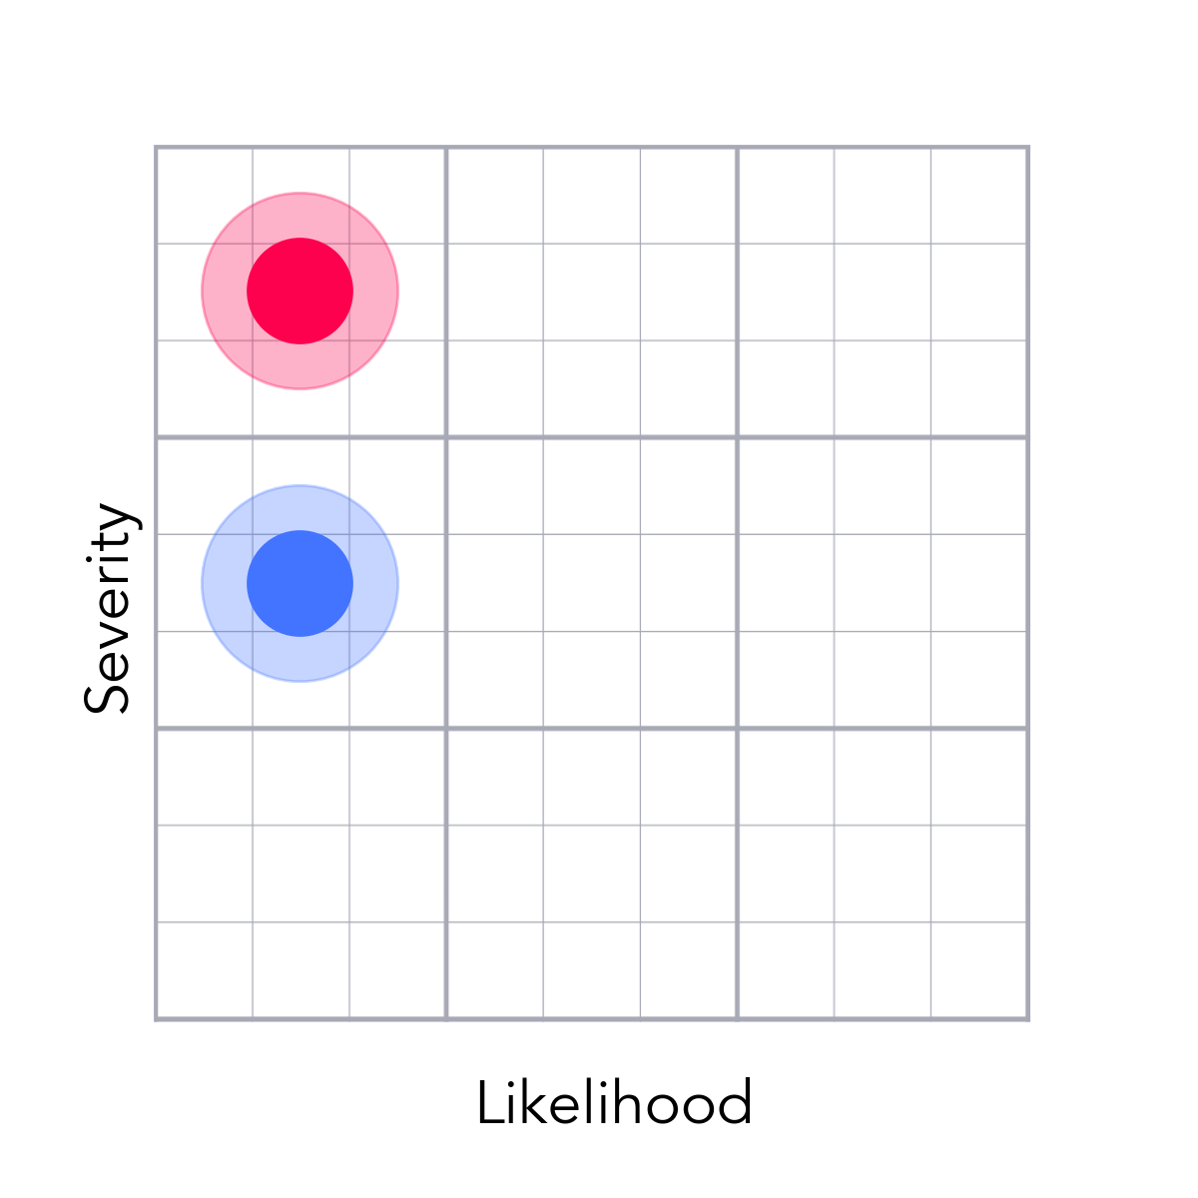
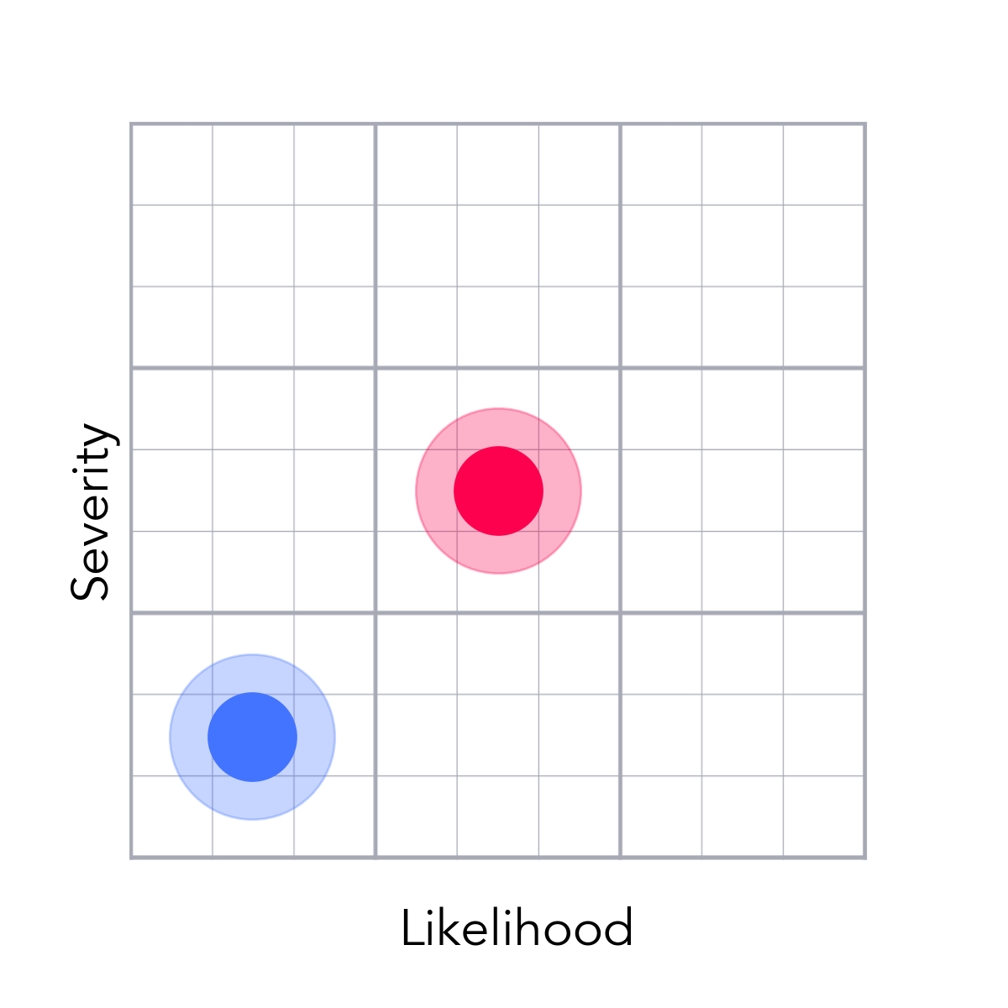
Top 20 Risks Overview
Test8
Test1
Test25
Test23
Test20
Test17
p.3
p.4
p.5
p.6
p.7
p.8
Test15
Test9
Test24
Test19
Test16
Test26
p.9
p.10
p.11
p.12
p.13
p.14
Test21
Test18
Test12
Test5
Test4
Test3
p.15
p.16
p.17
p.18
p.19
p.20

Slide 3
Slow Bureau Processes Put Pressure on Timelines
Test8
Red tape around bureau agreements have unpredictable timelines
Development and QA will have delayed access to Bureau specific short-codes and environments
The schedule would be delayed and we miss Q1 delivery
Work with bureaus to create gap contracts that will allow us early access to components. Streamline negotiations, contract review, and legal approval processes.
Develop the architecture and user experience without dependencies on all three bureaus so that we can remove certain bureaus from production environments and launch with less than three bureaus
Credit Repair
Adam
Mitigated

Slide 4
Inability to Process Documents Breaks 3D Credit
Test1
There isn’t a document management solution slated for initial SF release.
This compromises 3D credit because we use uploaded documents and categorize them so we can send the appropriate response interventions.
Not only will the inability to send response interventions hurt removal efficacy, but we have also testified in court that our current policy is to stop subsequent creditor interventions anytime we are apprised that a consumer has received documentary information that we requested.
nan
nan
Logged in
Adam
Needs Plan

Slide 5
We Need to Vet Breaking Points in Our Systems
Test25
Various disparate systems that need to communicate and transfer information to each other — what is being sent won't be what is expected and get an error
Customer records where customer accounts aren't recognized (can't log in) or customers don't get reward it money or
Customers can't access or use products as designed
Thoroughly vet systems with end-to-end testing, end user testing with private betas (Friends & Family 50 and Ambassador 250 prior to a general launch.
Set the standards to pass out of beta testing and don't allow a product in the market that cannot pass our minimum standards.
Logged in
Adam
Mitigated

Slide 6
FIs Tend to Give Delayed Feedback on Payouts
Test23
We don't always hear from FIs in a timely manner that a subscriber was approved for credit.
Subscribers don't get their money
Frustrated subscribers spike customer service tickets and churn at high rates
Set clear expectations that customers will get payment "after 1-2 billing cycles" by spotlighting the information clearly before they apply
Manage customer satisfaction through zen desk support tickets to clarify and track down payments
Logged in
Adam
Mitigated

Slide 7
We Need to Vet Breaking Points in Our Systems
Test20
Various disparate systems that need to communicate and transfer information to each other — what is being sent won't be what is expected and get an error
Customer records where customer accounts aren't recognized (can't log in) or customers don't get reward it money or
Customers can't access or use products as designed
Thoroughly vet systems with end-to-end testing, end user testing with private betas (Friends & Family 50 and Ambassador 250 prior to a general launch.
Set the standards to pass out of beta testing and don't allow a product in the market that cannot pass our minimum standards.
Credit Repair
Adam
Mitigated

Slide 8
We Need to Vet Breaking Points in Our Systems
Test17
Various disparate systems that need to communicate and transfer information to each other — what is being sent won't be what is expected and get an error
Customer records where customer accounts aren't recognized (can't log in) or customers don't get reward it money or
Customers can't access or use products as designed
Thoroughly vet systems with end-to-end testing, end user testing with private betas (Friends & Family 50 and Ambassador 250 prior to a general launch.
Set the standards to pass out of beta testing and don't allow a product in the market that cannot pass our minimum standards.
Logged in
Adam
Mitigated

Slide 9
FIs Tend to Give Delayed Feedback on Payouts
Test15
We don't always hear from FIs in a timely manner that a subscriber was approved for credit.
Subscribers don't get their money
Frustrated subscribers spike customer service tickets and churn at high rates
Set clear expectations that customers will get payment "after 1-2 billing cycles" by spotlighting the information clearly before they apply
Manage customer satisfaction through zen desk support tickets to clarify and track down payments
Logged in
Adam
Mitigated

Slide 10
Nearshore Development Carries Challenges
Test9
Important modules are dependent on outsourced teams where communication is challenging
Communication is challenged or broken between internal and external teams
Quality of work
Manage resources tightly and with regular check-ins and demos
Bring failing components inhouse to manage more tightly
Logged in
Adam
Mitigated

Slide 11
Resources Spread Thin Across Multiple Initiatives
Test24
CCPA, PCI, SFDC 2020 priorities
Resources will have to jump onto other projects to address fires and issues
Resource scarcity pushing back timelines
Block out key resources through beta testing and until launch
Have strategic discussions with executive team members to prioritized against the company vision and most important needs of the organization.
Credit Repair
Adam
Mitigated

Slide 12
Resources Spread Thin Across Multiple Initiatives
Test19
CCPA, PCI, SFDC 2020 priorities
Resources will have to jump onto other projects to address fires and issues
Resource scarcity pushing back timelines
Block out key resources through beta testing and until launch
Have strategic discussions with executive team members to prioritized against the company vision and most important needs of the organization.
Logged in
Adam
Mitigated

Slide 13
Resources Spread Thin Across Multiple Initiatives
Test16
CCPA, PCI, SFDC 2020 priorities
Resources will have to jump onto other projects to address fires and issues
Resource scarcity pushing back timelines
Block out key resources through beta testing and until launch
Have strategic discussions with executive team members to prioritized against the company vision and most important needs of the organization.
Credit Repair
Adam
Mitigated

Slide 14
Service Partners Have Competing B2C Products
Test26
We have major partners (Experian, & Level Credit) who also have B2C products in the space
Partners may seek to drop us after launch
The product will have gaps in feature sets, we won't be able to fulfill our promises to consumers, and we'll lose customers while having difficulty attracting new ones
Establish strong, mutually beneficial business agreements with the key strategic partners and make it difficult for them to sever ties.
Develop abilities to fill the gaps and build credit with other strategies. Limit dependencies on Experian and form a narrative around 2 bureau reports.
Credit Repair
Adam
Mitigated

Slide 15
Service Partners Have Competing B2C Products
Test21
We have major partners (Experian, & Level Credit) who also have B2C products in the space
Partners may seek to drop us after launch
The product will have gaps in feature sets, we won't be able to fulfill our promises to consumers, and we'll lose customers while having difficulty attracting new ones
Establish strong, mutually beneficial business agreements with the key strategic partners and make it difficult for them to sever ties.
Develop abilities to fill the gaps and build credit with other strategies. Limit dependencies on Experian and form a narrative around 2 bureau reports.
Logged in
Adam
Mitigated

Slide 16
Service Partners Have Competing B2C Products
Test18
We have major partners (Experian, & Level Credit) who also have B2C products in the space
Partners may seek to drop us after launch
The product will have gaps in feature sets, we won't be able to fulfill our promises to consumers, and we'll lose customers while having difficulty attracting new ones
Establish strong, mutually beneficial business agreements with the key strategic partners and make it difficult for them to sever ties.
Develop abilities to fill the gaps and build credit with other strategies. Limit dependencies on Experian and form a narrative around 2 bureau reports.
Credit Repair
Adam
Mitigated

Slide 17
We Need to Close Gaps in Media Reporting
Test12
Nightmarish paid media reporting
nan
nan
Build comprehensive reporting deck with all the criteria needed to effectively manage the marketing spend
Set the standards to pass out of beta testing and don't allow a product in the market that cannot pass our minimum standards.
Credit Repair
Adam
Mitigated

Slide 18
We Need a Simple Hook for Marketing
Test5
Complexity and vastness of product features
Difficult to create concise marketing messaging that will resonate with consumers and communicate value effectively
Confused users won't subscribe putting pressure on volume
Develop a compelling and informative "Launch Pad" experience and pithy product marketing descriptions to make the product components compelling and easy to understand
Develop tailored Re-engagment campaigns folded into a customer experience communications plan
Logged in
Adam
Mitigated

Slide 19
Build It Needs To Fullfil Member Expectations
Test4
Anecdotal use of Credit Pop (Level Credit, a.k.a., RentTrack) didn't make a difference in a team member's score
Consumers don't see score improvement results from Build IT
Consumers don't see value from Build It feature set
Set expectations with messaging; set messaging to the right target audience
Develop abilities to fill the gaps and build credit with other strategies.
Credit Repair
Adam
Mitigated

Slide 20
Consumers May Be Sensitive to Fees Above $10
Test3
We have a belief that subscription fees above $10 are more highly scrutinized by consumers
Difficulty to acquire clients
Pressure to LTV
Minimize subscription costs and clearly outline the value to the consumer
Price test in 2021 to find the optimal price points for volume and profitability
Logged in
Adam
Mitigated

Slide 21
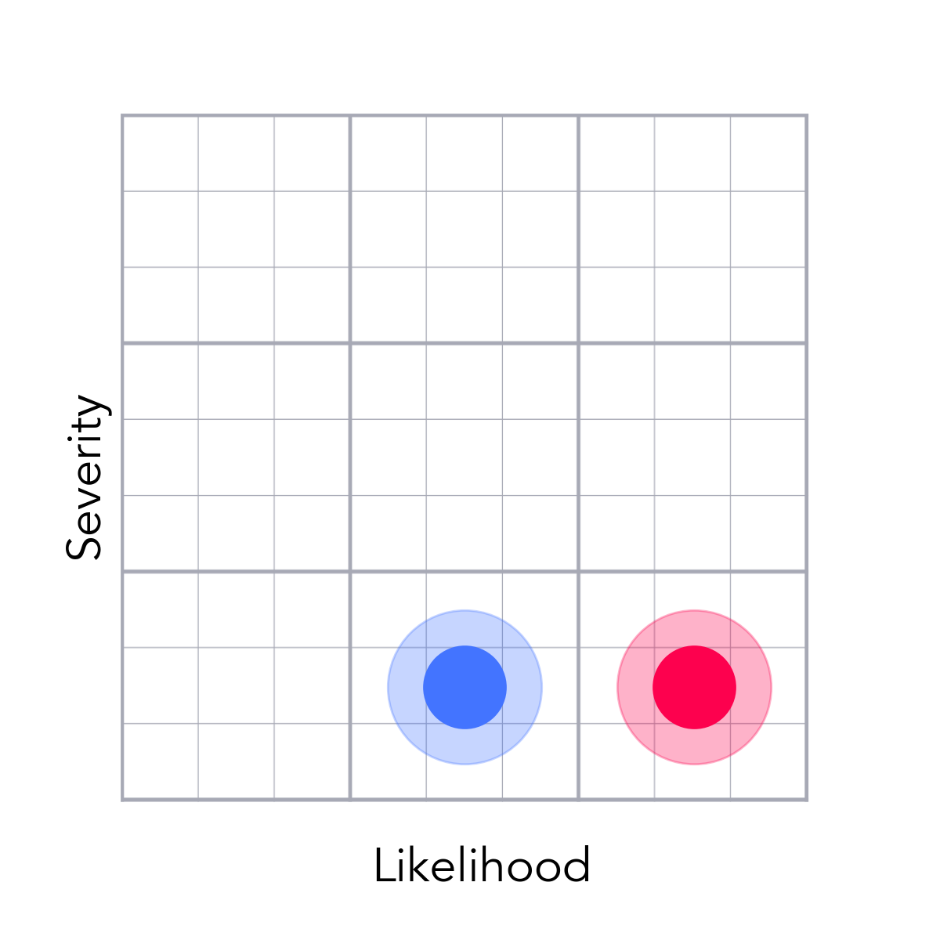
We Need to Vet Breaking Points in Our Systems
Test22
Environments not matching
nan
nan
Thoroughly vet systems with end-to-end testing, end user testing with private betas (Friends & Family 50 and Ambassador 250 prior to a general launch.
Set the standards to pass out of beta testing and don't allow a product in the market that cannot pass our minimum standards.
Credit Repair
Adam
Mitigated

Slide 22
We Need to Vet Breaking Points in Our Systems
Test14
Environments not matching
nan
nan
Thoroughly vet systems with end-to-end testing, end user testing with private betas (Friends & Family 50 and Ambassador 250 prior to a general launch.
Set the standards to pass out of beta testing and don't allow a product in the market that cannot pass our minimum standards.
Credit Repair
Adam
Mitigated

Slide 23
Compressed Timelines Leaves Less Time for QA
Test11
Truncated QA schedule
We aren't able to catch all development issues.
Production errors.
Put more on UAT to cover all look and feel QA responsibilities
Launch to limited audiences prior to a general launch
Logged in
Adam
Mitigated

Slide 24
Media is Expensive in an Election Year
Test10
Election in 2020
Media costs up; attention down
Pressure on LTV and volume
Push to get the product into the public market by early summer, ramp up spend early, and ramp down as we get into competitive spending season. Thoroughly optimize the database marketing funnel and build a DB marketing war chest with a "wishlist" campaign during private betas
Reduce spend that does not meet our CPA targets
Credit Repair
Adam
Mitigated

Slide 25
Payouts On Reward It Need To Be Swift
Test7
Getting approval feedback from FI partners can sometimes take weeks to get
Subscribers have to wait with little transparency into the timelines or status of their rewards
Frustrated subscribers spike customer service tickets and churn at high rates
Set clear expectations that customers will get payment "after 1-2 billing cycles" by spotlighting the information clearly before they apply
Manage customer satisfaction through zen desk support tickets to clarify and track down payments
Logged in
Adam
Mitigated

Slide 26
Customers Need To Stay Members for 20 Months
Test2
Direct care customers typically stay 8 months less than our target
Modeled assumptions of the financial plan get missed
Pressure on LTV
Have reporting that tightly monitors and understands customer life with early predictive models
Develop tailored Re-engagment campaigns folded into a customer experience communications plan
Credit Repair
Adam
Mitigated

Slide 27
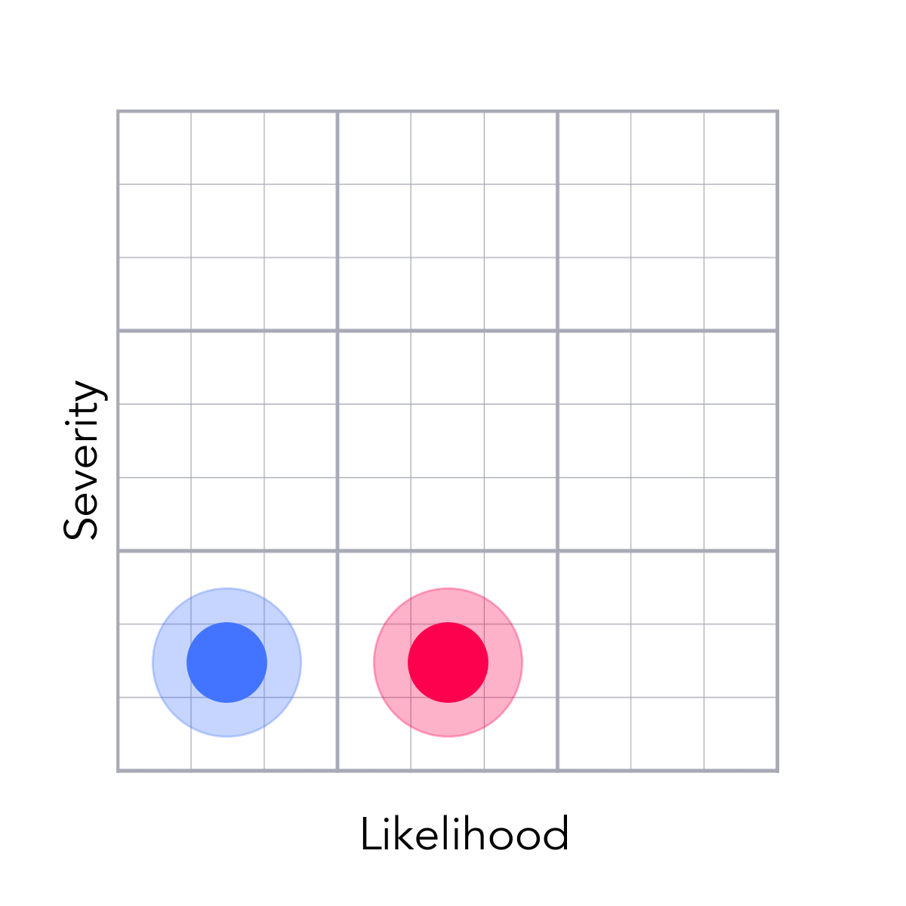
User Experiences Need to Be Steller on All Devices
Test13
Rollouts of the http://creditrepair.com hybrid app showed bugs and errors because UI was better optimized for mobile web versus mobile apps
Poor user experiences in mobile apps
Frustrated subscribers spike customer service tickets and churn at high rates
Thoroughly vet systems with end-to-end testing, end user testing with private betas (Friends & Family 50 and Ambassador 250 prior to a general launch.
Push clients to the web interface as the primary means to engage
Logged in
Adam
Mitigated

Slide 28
We Cannot Increase Support Tickets To Our FIs
Test6
Chase reports customer service issues go directly to them versus us
Our relationship with FI brands is compromised
The value to the consumer goes down as we aren't able to offer our highest rewards; Business viability goes down as we forego FI revenue.
Clear messaging about a "General Program"; callout in HERO PLACEMENT
Tightly monitor and get feedback from FIs about any issues
Credit Repair
Adam
Mitigated

